Slide 1
Chapter 1: Introduction to Scaling Networks
Scaling Networks
Notes:
Cisco Networking Academy program
Scaling Networks
Chapter 1: Introduction to Scaling Networks

Slide 2
Chapter 1
1.0 Introduction
1.1 Implementing a Network Design
1.2 Selecting Network Devices
1.3 Summary
Notes:
Chapter 1

Slide 3
Chapter 1: Objectives
Describe the use of a hierarchical network for a small business.
Describe recommendations for designing a network that is scalable.
Describe the type of switches available for small-to-medium-sized business networks.
Describe the type of routers available for small-to-medium-sized business networks.
Configure and verify basic settings on a Cisco IOS device.
Notes:
Chapter 1 Objectives

Slide 4
1.1 Implementing a Network Design
Scaling Networks
Notes:
1.1 Implementing a Network Design

Slide 5
Hierarchical Network Design Network Scaling Needs
As they grow and expand, all enterprise networks must:
Support critical applications
Support converged network traffic
Support diverse business needs
Provide centralized administrative control
Notes:
1.1.1.1 The Need to Scale the Network

Slide 6
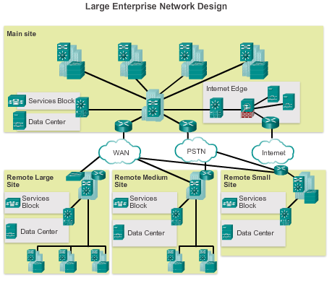
Hierarchical Network Design Enterprise Business Devices
To provide a high-reliability network, enterprise class equipment is installed in the enterprise network.
Notes:
1.1.1.2 Enterprise Business Devices

Slide 7
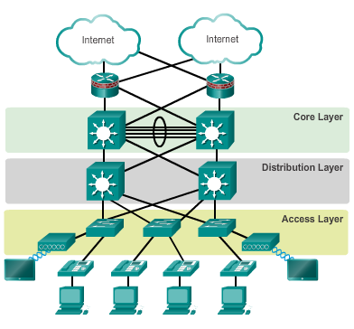
Hierarchical Network Design Hierarchical Network Design
This model divides the network functionality into three distinct layers.
Notes:
1.1.1.3 Hierarchical Network Design

Slide 8
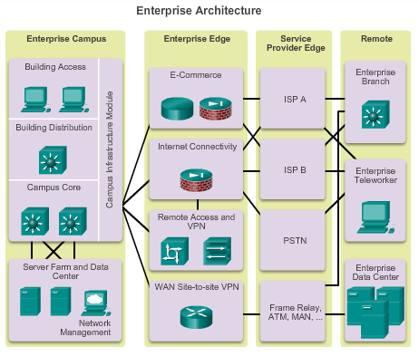
Hierarchical Network Design Cisco Enterprise Architecture
The primary Cisco Enterprise Architecture modules include:
Enterprise Campus
Enterprise Edge
Service Provider Edge
Remote
Notes:
1.1.1.4 Cisco Enterprise Architecture

Slide 9
Hierarchical Network Design Failure Domains
Failure Domains are areas of a network that are impacted when a critical device or network service experiences problems.
Redundant links and enterprise class equipment minimize disruption of network.
Smaller failure domains reduce the impact of a failure on company productivity.
Smaller failure domains also simplify troubleshooting.
Switch block deployment – each switch block acts independently of the others. Failure of a single device does not impact the whole network.
Notes:
1.1.1.5 Failure Domains

Slide 10
Expanding the Network Designing for Scalability
Use expandable, modular equipment or clustered devices.
Include design modules that can be added, upgraded, and modified, without affecting the design of the other functional areas of the network.
Create a hierarchical addressing scheme.
Use routers or multilayer switches to limit broadcasts and filter traffic.
Notes:
1.1.2.1 Design for Scalability

Slide 11
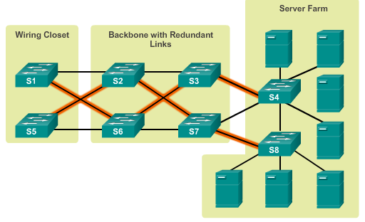
Expanding the Network Planning for Redundancy
Installing duplicate equipment
Providing redundant paths
Notes:
1.1.2.2 Planning for Redundancy

Slide 12
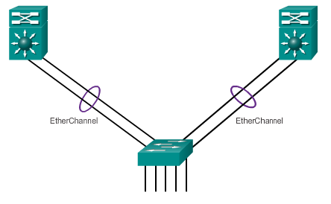
Expanding the Network Increasing Bandwidth
Link aggregation increases the amount of bandwidth between devices by creating one logical link made up of several physical links.
EtherChannel is a form of link aggregation used in switched networks.
Notes:
1.1.2.3 Increasing Bandwidth

Slide 13
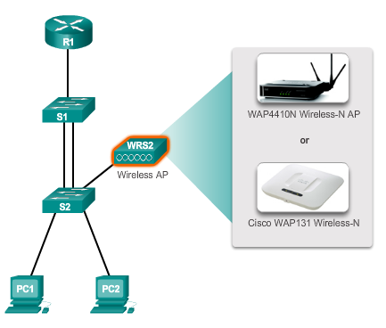
Expanding the Network Expanding the Access Layer
Access layer connectivity can be extended through wireless connectivity.
Notes:
1.1.2.4 Expanding the Access Layer

Slide 14
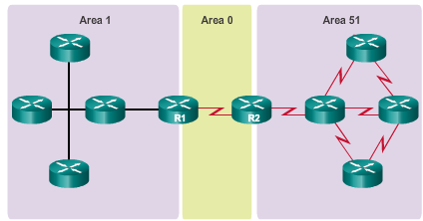
Expanding the Network Fine-Tuning Routing Protocols
OSPF works well for large, hierarchical networks.
Notes:
1.1.2.5 Fine-tuning Routing Protocols

Slide 15
1.2 Selecting Network Devices
Scaling Networks
Notes:
1.2 Selecting Network Devices

Slide 16
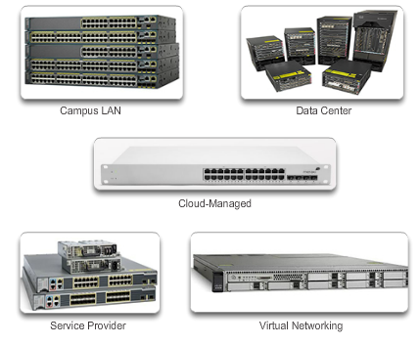
Switch Hardware Switch Platforms
Select form factor:
Fixed
Modular
Stackable
Non-stackable
Notes:
1.2.1.1 Switch Platforms

Slide 17
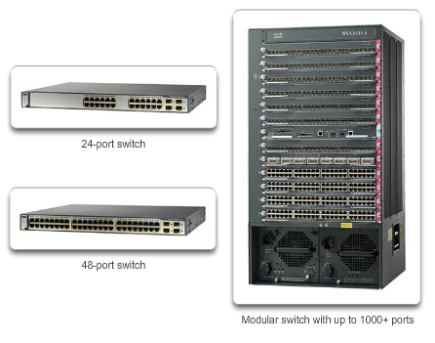
Switch Hardware Port Density
Notes:
1.2.1.2 Port Density

Slide 18
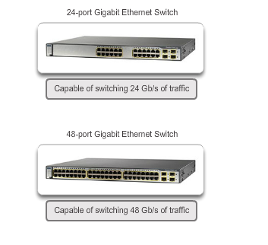
Switch Hardware Forwarding Rates
The processing capabilities of a switch are rated by how much data the switch can process per second.
Notes:
1.2.1.3 Forwarding Rates

Slide 19
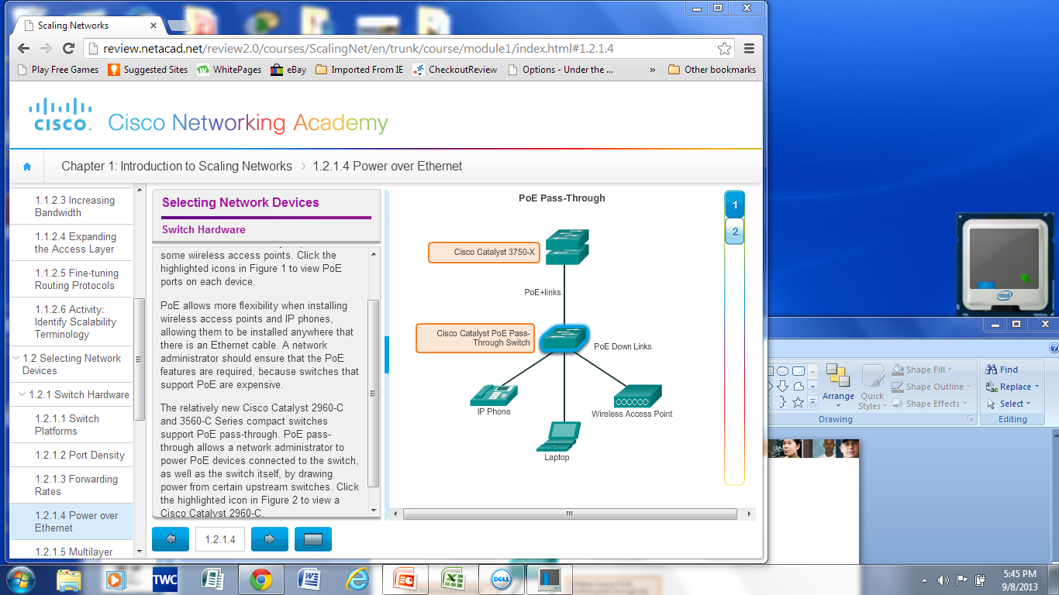
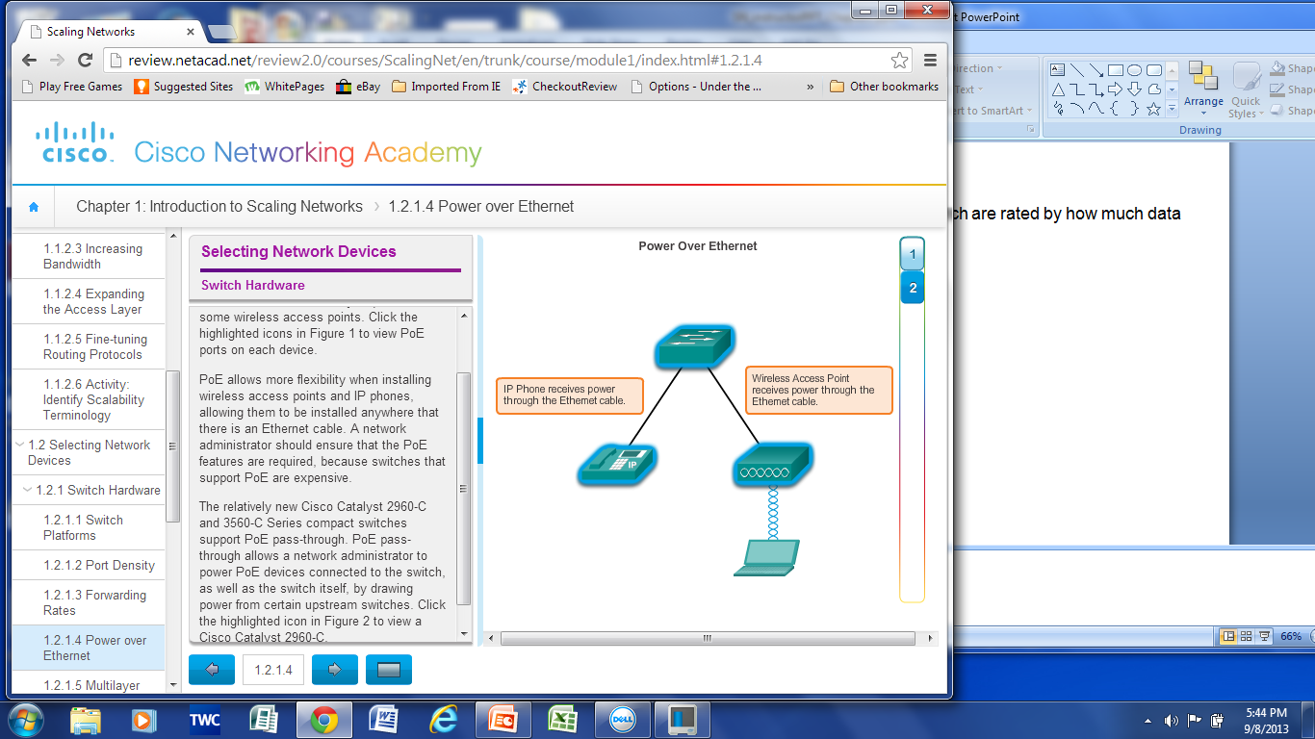
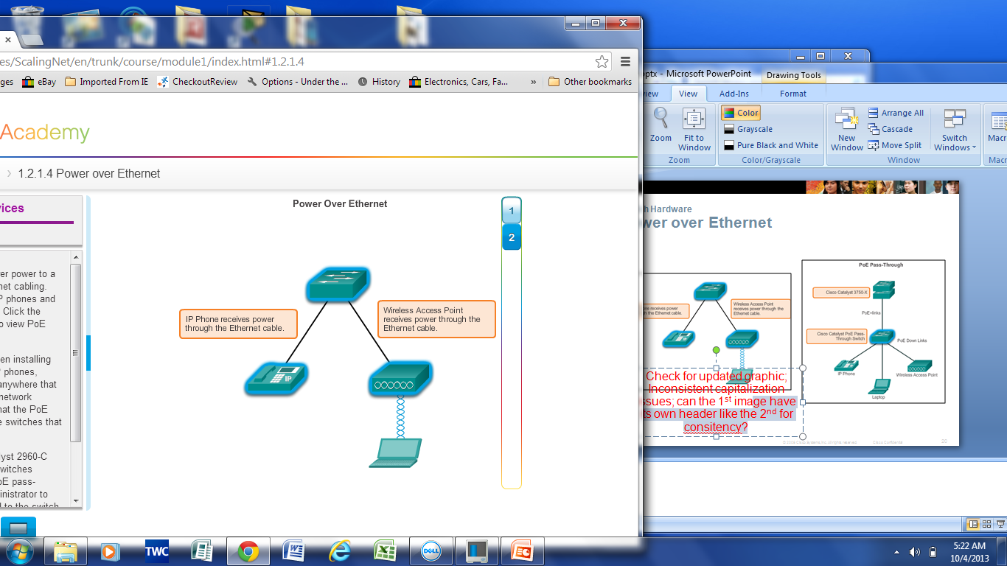
Switch Hardware Power over Ethernet
Notes:
1.2.1.4 Power over Ethernet

Slide 20
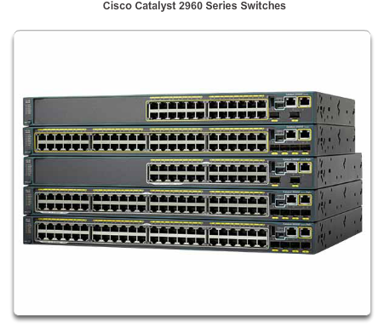
Switch Hardware Multilayer Switching
Deployed in the core and distribution layers of an organization’s switched network.
Can build a routing table, support a few routing protocols, and forward IP packets.
Notes:
1.2.1.5 Multilayer Switching

Slide 21
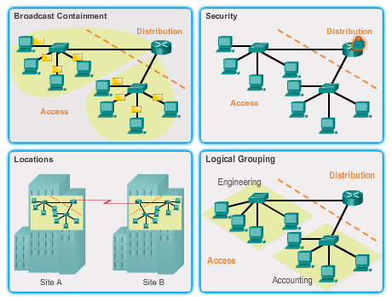
Router Hardware Router Requirements
Role of routers:
Interconnect multiple sites
Provide redundant paths
Connect ISPs
Translate between media types and protocols
Notes:
1.2.2.1 Router Requirements

Slide 22
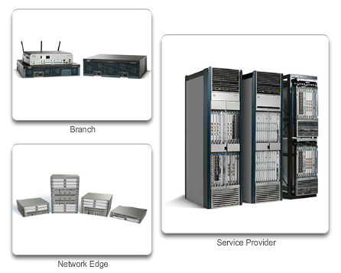
Router Hardware Cisco Routers
Three categories of routers:
Branch – Highly available 24/7.
Network Edge – High performance, high security, and reliable services. Connect campus, data center, and branch networks.
Service provider routers
Notes:
1.2.2.2 Cisco Routers

Slide 23
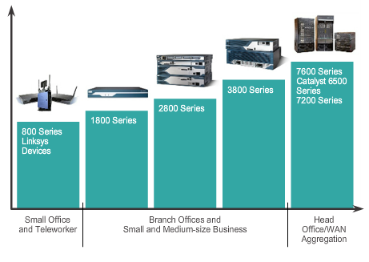
Router Hardware Router Hardware
Fixed configuration – Built-in interfaces.
Modular – Slots allow different interfaces to be added.
Notes:
1.2.2.3 Router Hardware

Slide 24
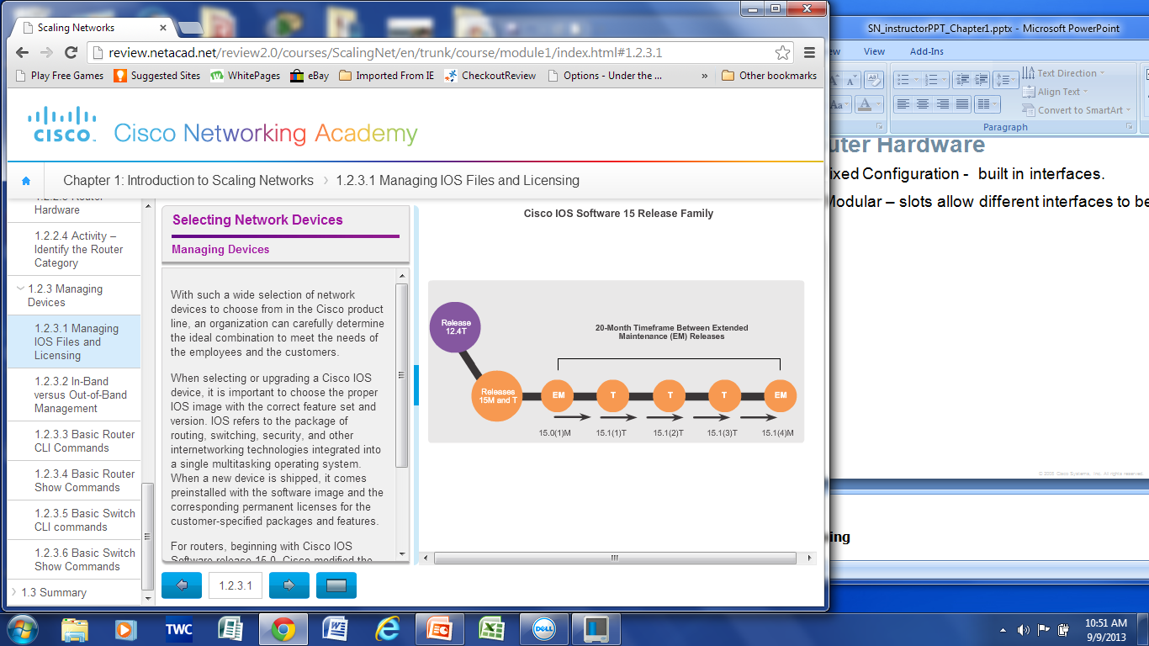
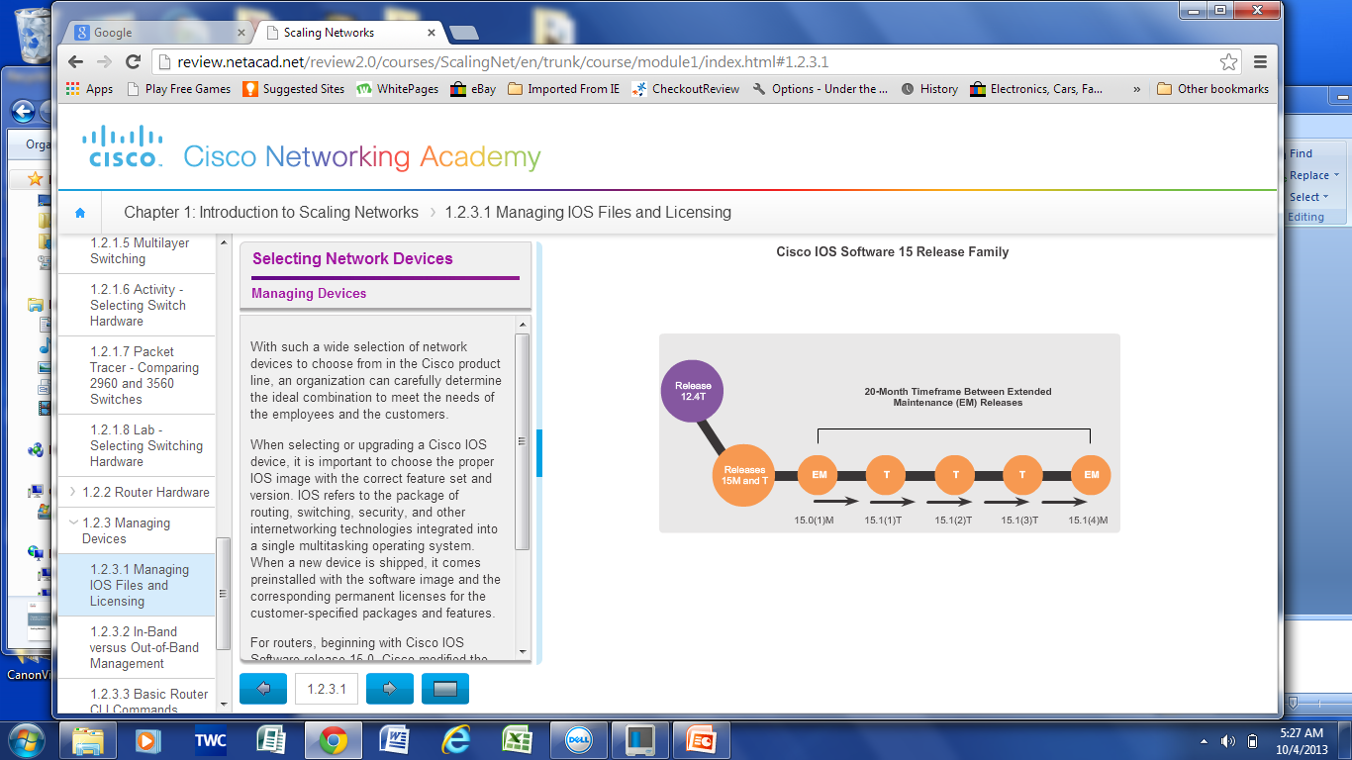
Managing Devices Managing IOS Files and Licensing
Notes:
1.2.3.1 Managing IOS Files and Licensing

Slide 25
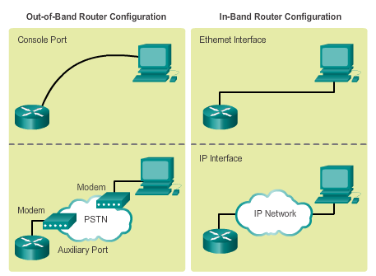
Managing Devices In-Band vs. Out-of-Band Management
In-Band requires, at least, one interface to be connected and operational and use of Telnet, SSH, or HTTP to access device.
Out-of-Band requires direct connection to console or AUX port and Terminal Emulation client to access device.
Notes:
1.2.3.2 In-Band versus Out-of-Band Management

Slide 26
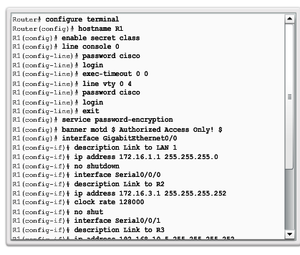
Managing Devices Basic Router CLI commands
Basic router configuration includes:
Hostname
Passwords (console, Telnet/SSH, and privileged mode)
Interface IP addresses
Enabling a routing protocol
Notes:
1.2.3.3 Basic Router CLI commands

Slide 27
Managing Devices Basic Router show Commands
show ip protocols – Displays information about routing protocol configured.
show ip route – Displays routing table information.
show ip ospf neighbor – Displays information about OSPF neighbors.
show ip interfaces – Displays detailed information about interfaces.
show ip interface brief – Displays all interfaces with IP addressing , interface, and line protocol status.
show cdp neighbors – Displays information about all directly connected Cisco devices.
Notes:
1.2.3.4 Basic Router Show Commands

Slide 28
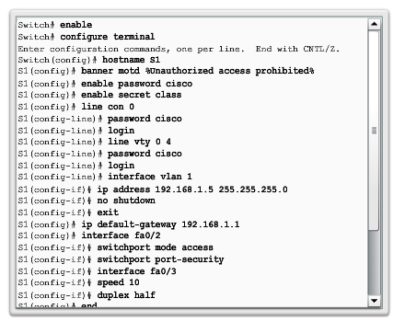
Managing Devices Basic Switch CLI Commands
Hostname
Passwords
In-Band access requires the Switch to have an IP address (assigned to VLAN 1).
Save configuration – copy running-config startup-config command.
To clear switch – erase startup-config, and then reload.
To erase VLAN information – delete flash:vlan.dat.
Notes:
1.2.3.5 Basic Switch CLI commands

Slide 29
Managing Devices Basic Switch Show Commands
show port-security – Displays any ports with security enabled.
show port-security address – Displays all secure MAC addresses.
show interfaces – Displays detailed information about interfaces.
show mac-address-table – Displays all MAC addresses the switch has learned.
show cdp neighbors – Displays all directly connected Cisco devices.
Notes:
1.2.3.6 Basic Switch Show Commands

Slide 30
1.3 Summary
Scaling Networks
Notes:
1.3 Summary

Slide 31
Chapter 1: Summary
This chapter:
Introduces the hierarchical network design model that divides network functionality into the access layer, the distribution layer, and the core layer.
Describes how the Cisco Enterprise Architecture further divides the network into functional components called modules.
Defines how routers and multilayer switches are used to limit failure domains.
Explains that a good network design includes a scalable IP scheme, fast converging and scalable routing protocols, appropriate Layer 2 protocols and devices that are modular or easily upgraded.
Notes:
Chapter 1 Summary

Slide 32
Chapter 1: Summary (cont.)
Identifies that a mission-critical server should have a connection to two different access layer switches. It should also have redundant modules and backup power.
Recognizes that routers and switches should be selected from the appropriate categories to meet the network’s requirements.
Notes:
Chapter 1 Summary (continued)

Slide 33


